Slide 1
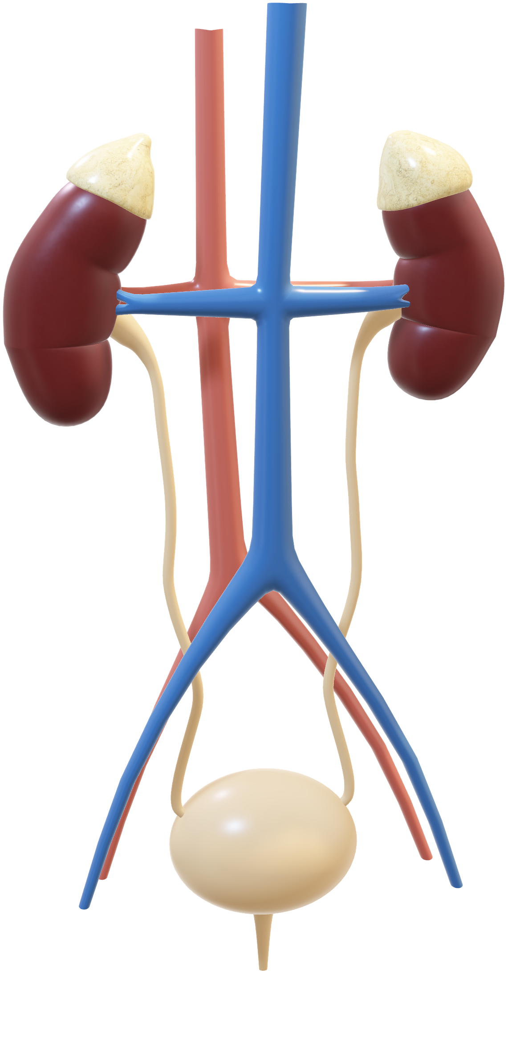
Automated Kidney Stone Detection USING IMAGE PROCESSING TECHNIQUES

Slide 2
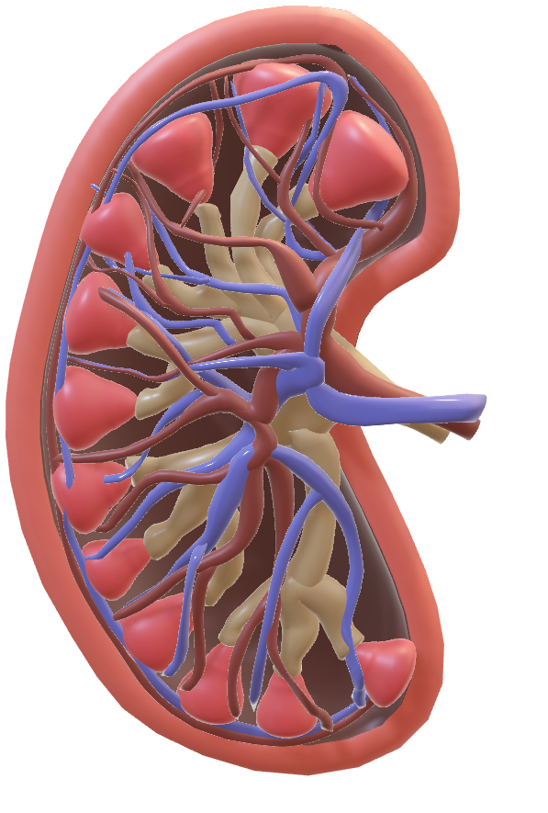
Introduction
Millions of individuals all around the world struggle with kidney stones, which is a frequent health issue. These are tiny, hard mineral and salt deposits that develop in the kidneys and can be quite painful and uncomfortable as they move through the urinary tract. Using conventional techniques to find kidney stones, such as CT scans and X-rays can be expensive and subject patients to ionizing radiation. Non-ionizing radiation, which is thought to be safer, is used in MRI scans. but very pricey for the average person to afford. Ultrasonic (US) scans, on the other hand, don't involve ionizing radiation and are safe for routine use. Ultrasound scans are less expensive than other scanning techniques, but they are not typically advised for the detection of stones because they are not very accurate in detecting tiny stones due to the disturbance in them, we can't expect accurate results.

Slide 3
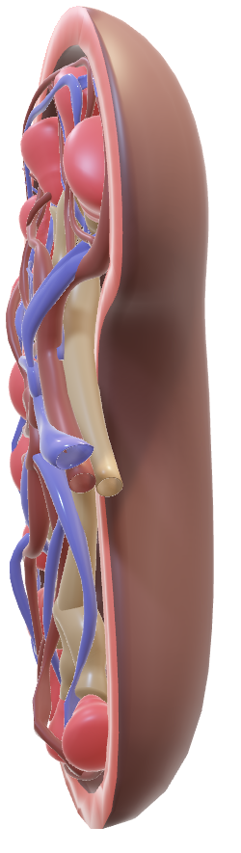

Abstract
Kidney stones are now a serious issue that, if not treated right away, can lead to complications and occasionally even require surgery to remove. Image processing can greatly increase the likelihood of accurately detecting stones well in advance. It has the propensity to produce accurate results and is an automatic method of finding the stone. Because kidney stones have low contrast and speckle noise, finding them via ultrasound imaging is a very difficult task. By using appropriate Image processing-MatLab approaches, this problem is solved. The speckle noise in the ultrasound image is first pre-processed using the image restoration technique. Stone placement detection was then performed using the reconstructed image.

Slide 4
Literature Survey
Viswanath and Gunasundari, published a research paper named after “Design and analysis performance of kidney stone detection from ultrasound image by level set segmentation and ANN classification” by lowering specific vitality levels that confirm the presence of urinary calculus in a specific area, improved accuracy in 2014.
Angshuman Khan, Rupayan Da and M C Parameshwara, published a research paper named after “Detection of kidney stone using digital Image processing: a holistic approach” finds whether the kidney scan image has stones in it or not but it doesn’t detect and calculate the size of the stone.
V. Romero, H. Akpinar, and D. G. Assimos, developed a method for detecting the object of interest (kidney stones) including its size and location in a digital KUB CT scan image.

Slide 5
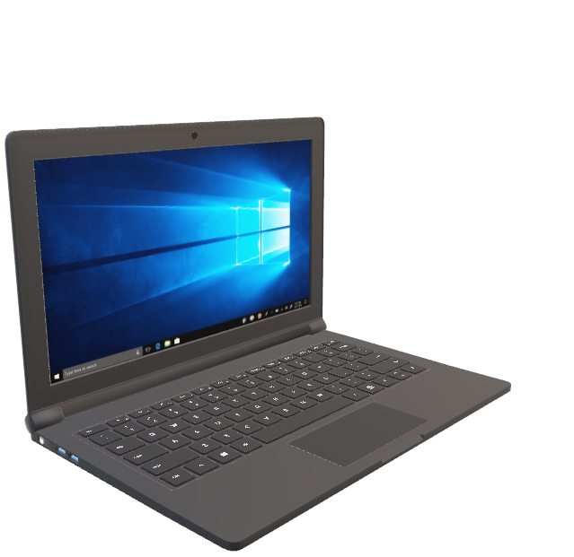
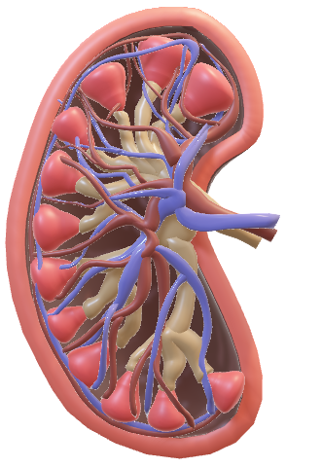
Requirement and Analysis
Processor : Any Intel or AMD x86–64 processor
RAM : Minimum: 4 GB
Software : MATLAB R2018a Version 9.4 or above
Storage : 4.0 GB for just MATLAB
5-8 GB for a installation of Image Processing, Open CV and
Digital Image Processing Modules
Graphics : No specific graphics card is required, but a hardware accelerated
graphics card supporting OpenGL 3.3 with 1GB GPU memory is recommended

Slide 6

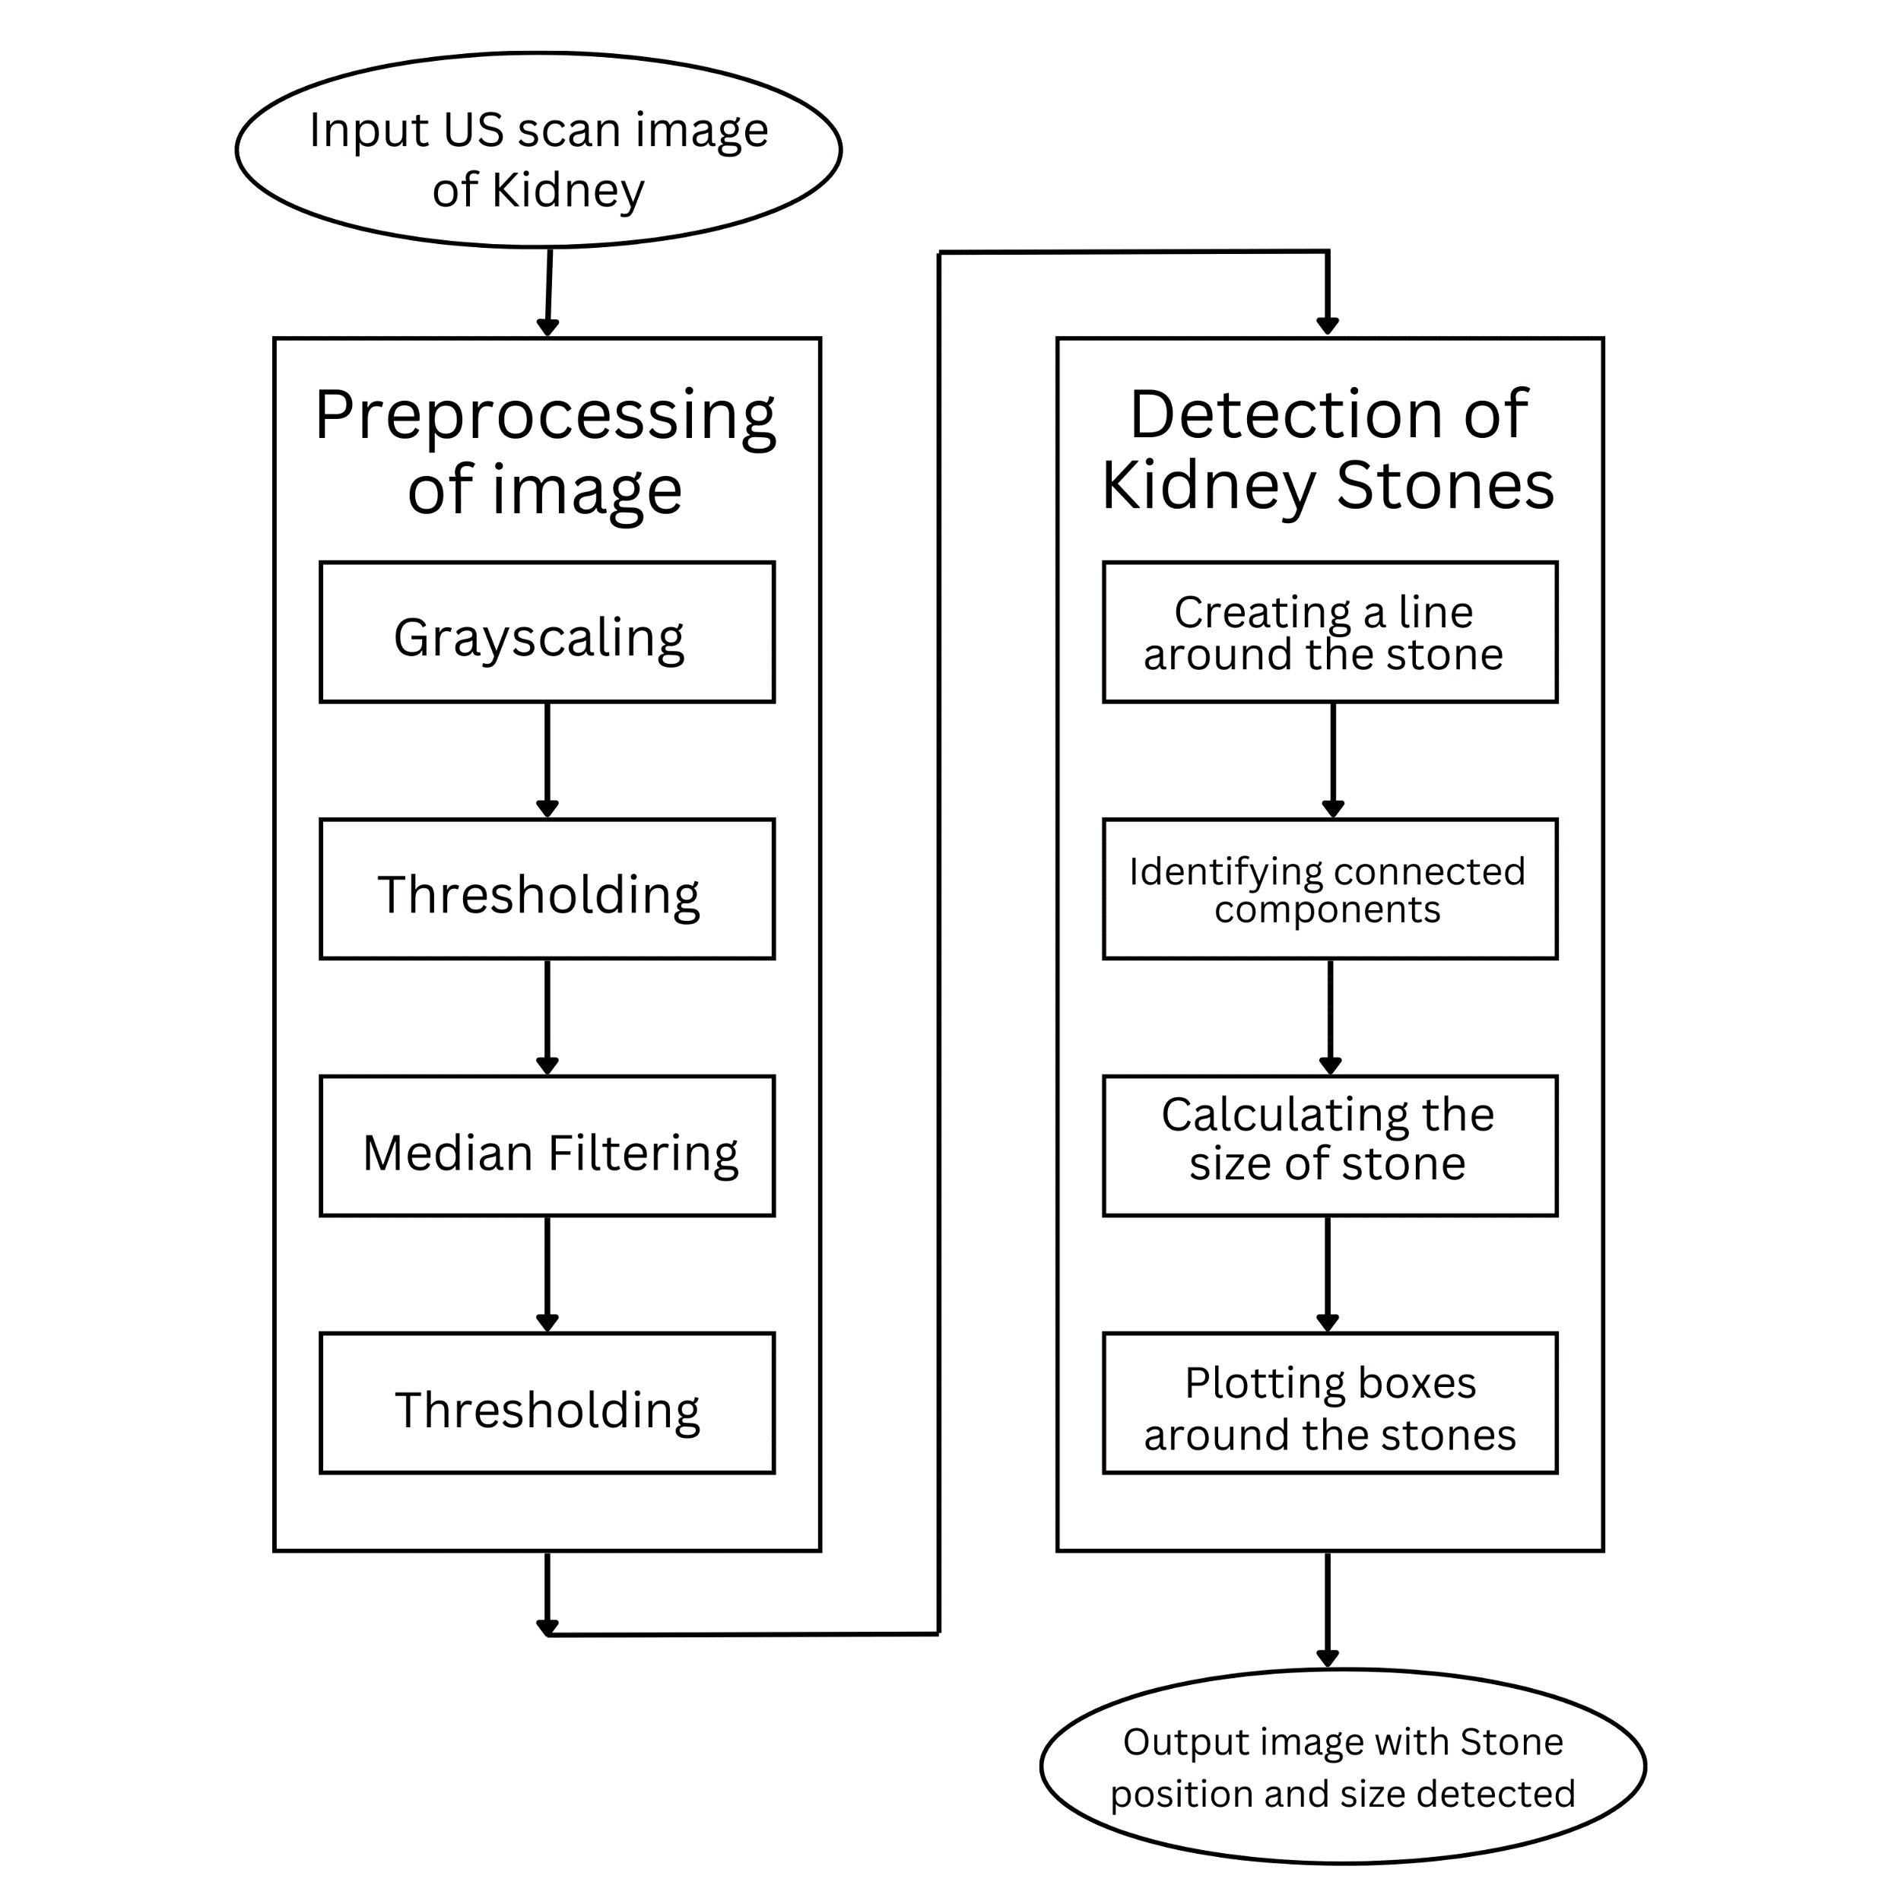
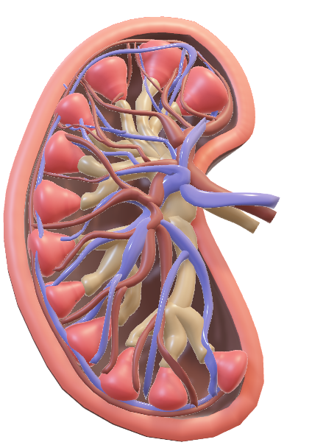
System Design

Slide 7
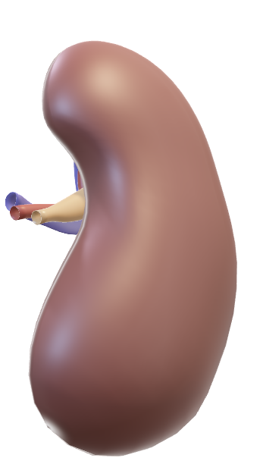
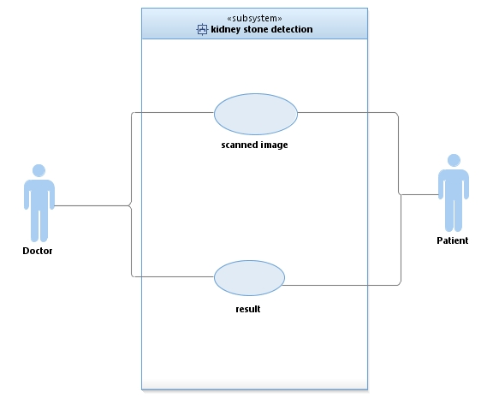
Use Case Diagram

Slide 8
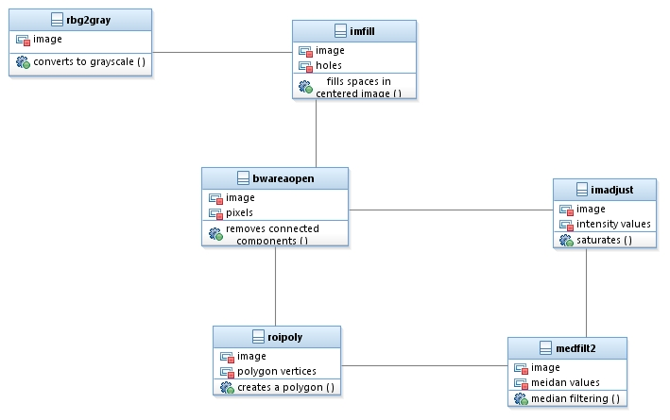
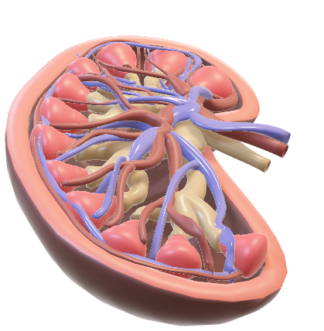
Class Diagram

Slide 9
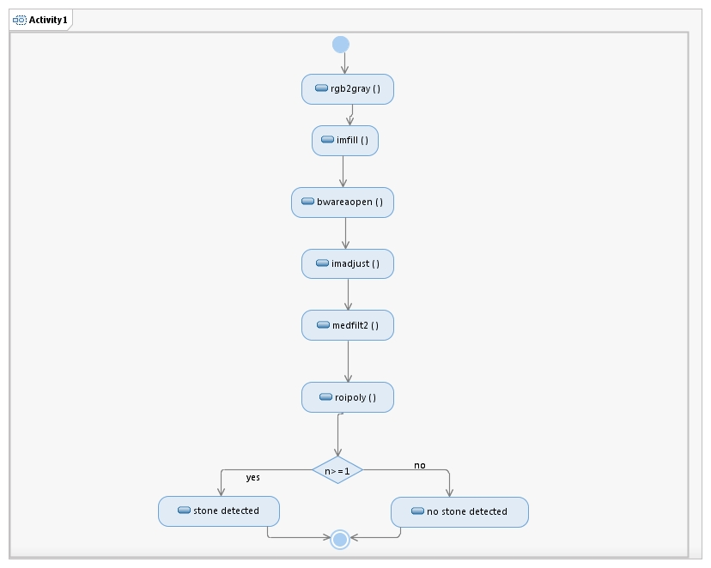
Activity Diagram

Slide 10
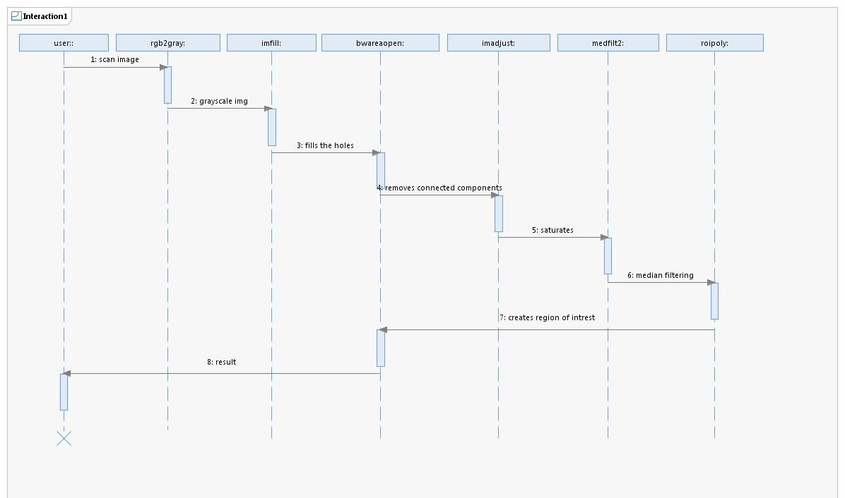
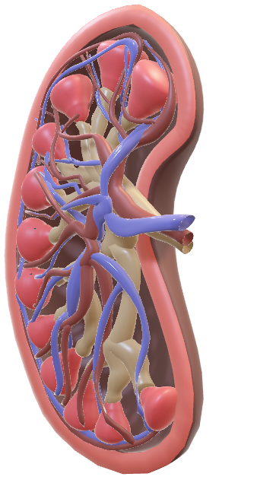
Sequence Diagram

Slide 11
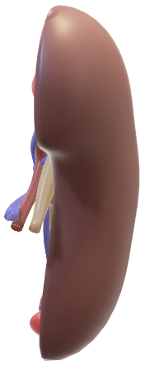
Implementation
Read the image file through the "uigetfile" function.
Convert the image to grayscale using "rgb2gray" function.
Apply thresholding to the grayscale image using the "b>20" condition and fill the holes in the image using "imfill" function.
Remove small objects from the image using "bwareaopen" function.
Apply median filtering to the image using "medfilt2" function.
Threshold the filtered image again using the "mo>250" condition.

Slide 12
Implementation
Get the dimensions of the image using the "size" function.
Create a line around the stone and select the ROI using "roipoly" function.
Label all connected components in the ROI using "bwlabel" function.
For each connected component (stone), calculate its size by summing the area and taking the square root of the result. Store the size in the "stoneSizes" array.
Draw rectangles around the stones using "rectangle" function and store the positions of the rectangles in the "rectPositions" array.
If stones are detected, display the image with rectangles and provide the size of each stone. If no stones are detected, display a message indicating the absence of stones.

Slide 13

Conclusion
The study found that the combination of these methods allowed for accurate detection of the stones, including their location and size. The results showed that the system was able to detect stones with high accuracy, making it a valuable tool for medical professionals. Additionally, the system could be integrated with other medical imaging modalities, such as ultrasound or CT scans, to provide a more comprehensive picture of the kidney and stone location. Further research could also be conducted to improve the system's performance and accuracy, making it an even more valuable tool for medical professionals.

Slide 14
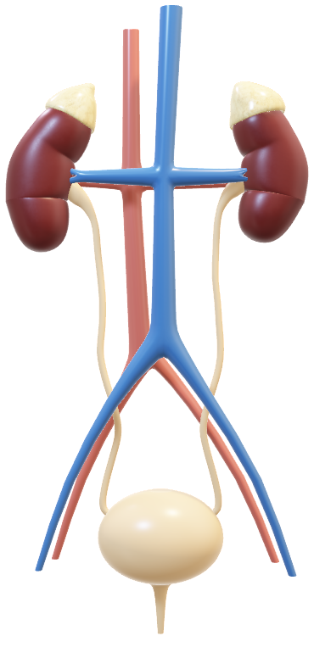

References
Tsao, Chang, and Lin in Ultrasonic Renal-Stone Detection and Identification for Extracorporeal Lithotripsy | IEEE Conference Publication | IEEE Xplore
Viswanath and Gunasundari Design and analysis performance of kidney stone detection from ultrasound image by level set segmentation and ANN classification | IEEE Conference Publication | IEEE Xplore
Angshuman Khan, Rupayan Das and M C Parameshwara https://iopscience.iop.org/article/10.1088/2631-8695/ac8b65 [4] Sakshi Garg, Angadpreet Walia, Abhilasha Singh & Anju Mishra A Study on Shape Detection: An Unexplored Parameter in the Gallstones Identification | SpringerLink
A renal ultrasound is a very useful exam which allows doctors to quickly evaluate the condition of kidneys without exposing patients to radiation or using IV contract. https://ic.steadyhealth.com/ultrasound-procedure-forkidney-stones
F. L. Coe, A. Evan, and E. Worcester, “Kidney stone disease,”Journal of Clinical Investigation, vol. 115, no. 10, pp. 2598-2608,2019 https://www.jci.org/articles/view/26662/pdf.
V. Romero, H. Akpinar, and D. G. Assimos, “Kidney stones: A global picture of prevalence, incidence, and associated risk factors,” Reviews in Urology, vol. 12, no. 2-3, pp. 86-96, 2019 https://www.semanticscholar.org/paper/Digital-Image-ProcessingGonz%C3%A1lez-Woods/72ce0faa2d0be574f5cb88cfe6353a3ba40a08ae
R. C. Gonzalez and R. E. Woods, Digital Image Processing, 2nd ed., 2019, ch. 2, pp. 47-51 and ch. 10, pp. 568-611 https://www.semanticscholar.org/paper/Digital-Image-ProcessingGonz%C3%A1lez-Woods/72ce0faa2d0be574f5cb88cfe6353a3ba40a08ae.
A. Rosenfeld and A. C. Kak, Digital Picture Processing, 2nd ed., Academic Press, 2018, ch. 10 https://www.sciencedirect.com/book/9780125973021/digital-pictureprocessing. 62
[Mehmet Baygin, Orhan Yaman, Prabal Datta Barua Exemplar Darknet19 feature generation technique for automated kidney stone detection with coronal CT images – ScienceDirect
Kidney Stone Detection using Ultrasound Images by Tanya Borges, Akash Rai, Dharm Raj, Danish Ather, Keshav Gupta :: SSRN.
A Gallery of High-Resolution, Ultrasound, Color Doppler & 3D Images (ultrasoundimages.com

Slide 15
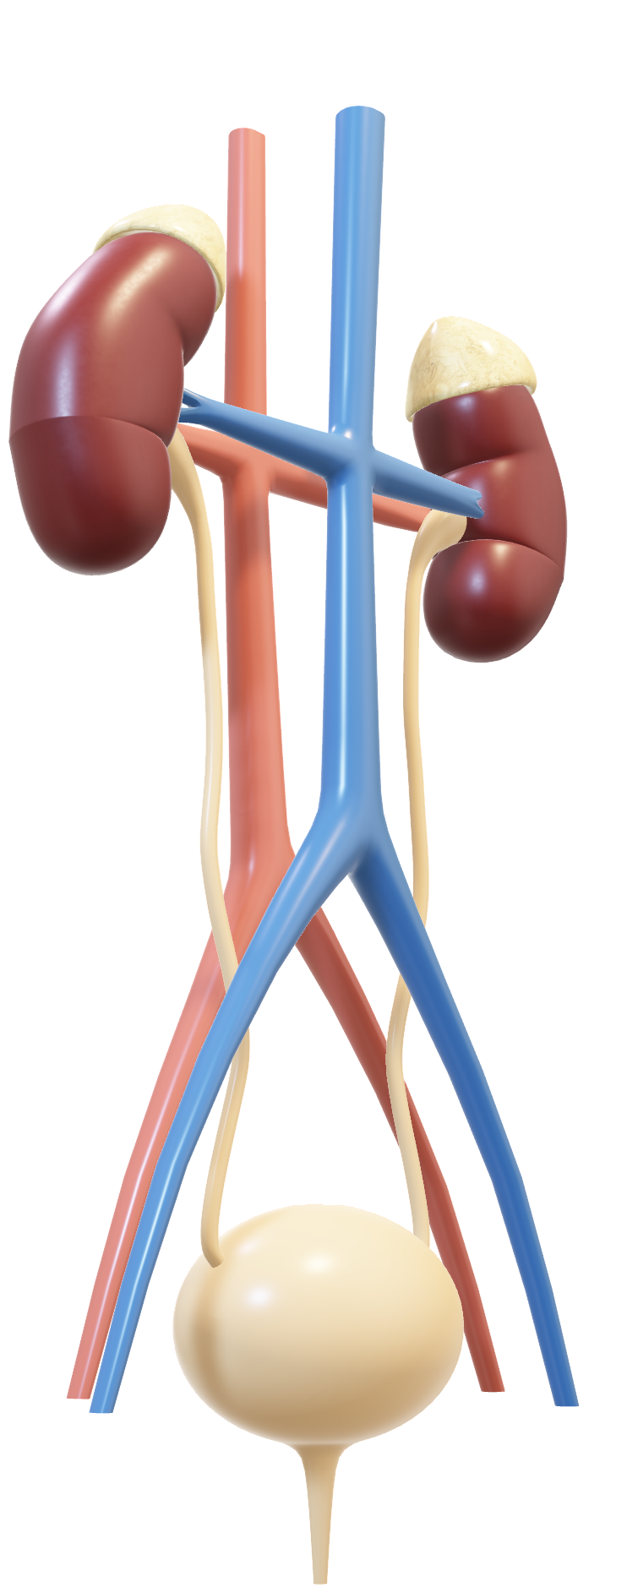
Thank You

